Slide 1
Lady Fern Marketplace
An online solution for local floristry business

Slide 2
The problem
This e-commerce web application is being developed for a local florist in order to boost their sales during the COVID-19 isolation period and beyond. With the strict social distancing rules set in place, this business owner is finding it difficult to continue regular operations as local markets and gatherings are no longer allowed to take place.
Global economy has been affected by this pandemic, and small business are finding it challenging to stay afloat. With the implementation of an online platform for selling goods, this allows businesses to continue to sustain themselves, whilst also driving the economy and potentially pulling the country further towards an economic upturn.

Slide 3
Design and development

Slide 4
Functions and Features
Creation, retrieval, updating and deletion of listings as well as functionality for transactions and order processing.
User account creation and authentication
Search capabilities
Admin Dashboard
Shopping Cart
Tech Stack:
HTML5
SCSS
Tailwind
JQuery
JS
Ruby on Rails
Puma
Heroku

Slide 5
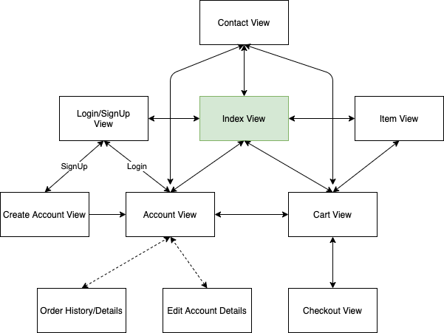
Site map

Slide 6
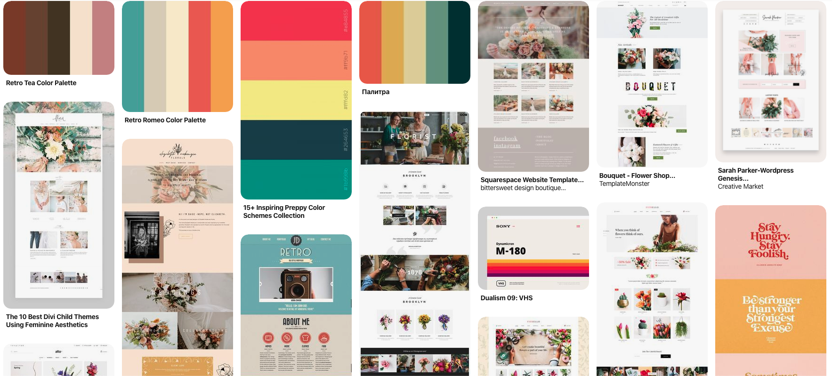
inspiration

Slide 7
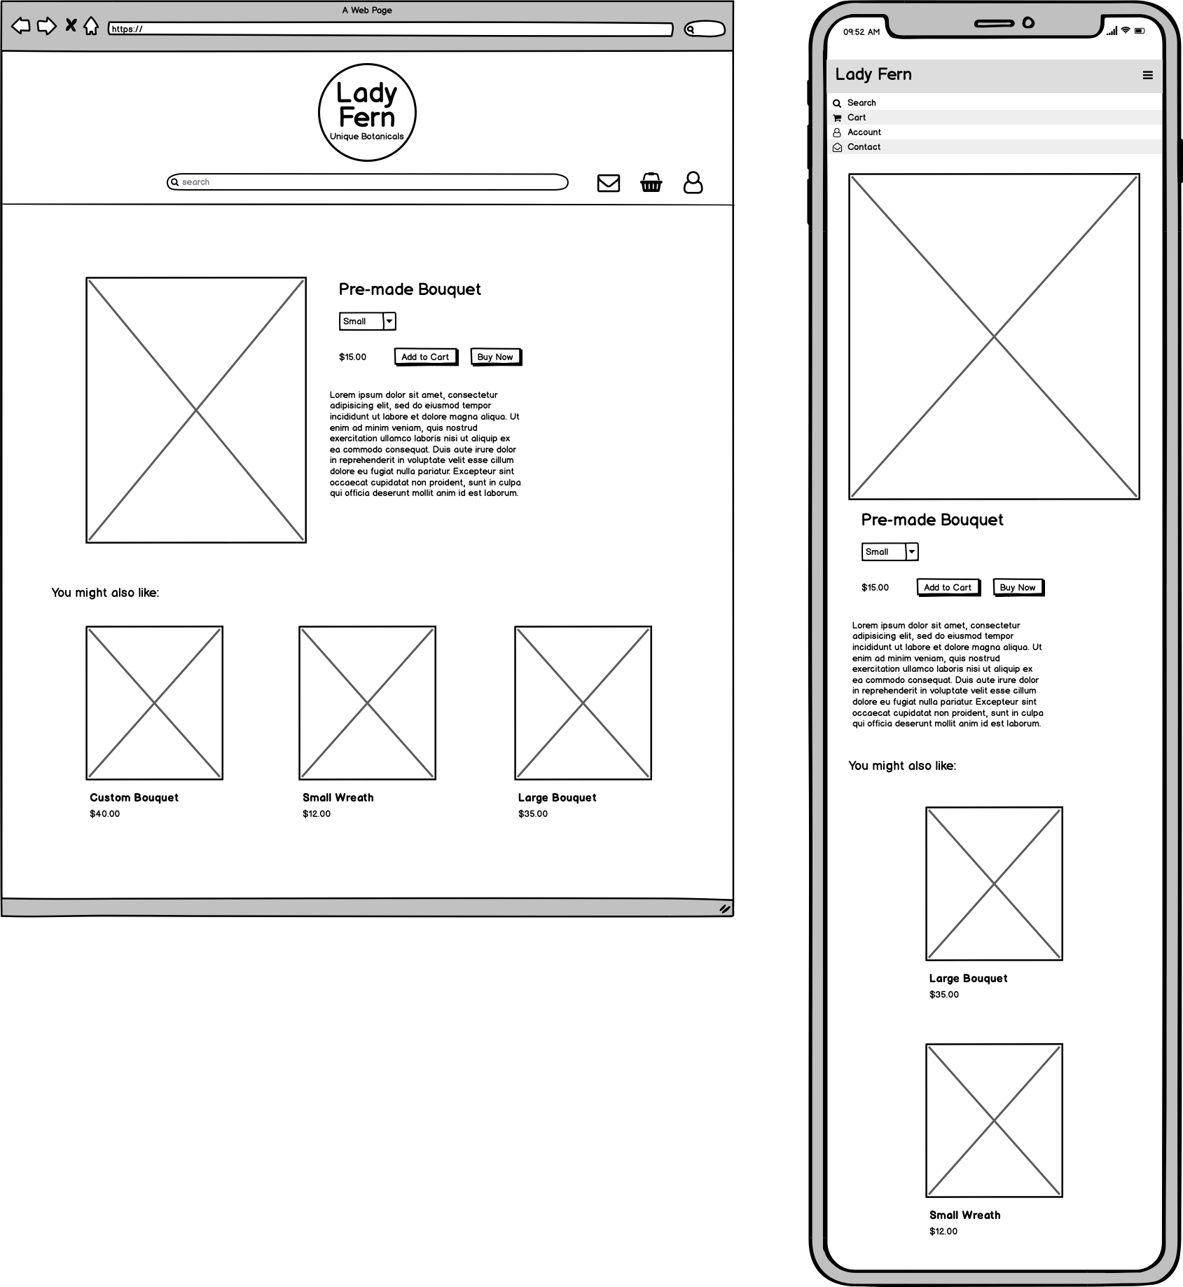
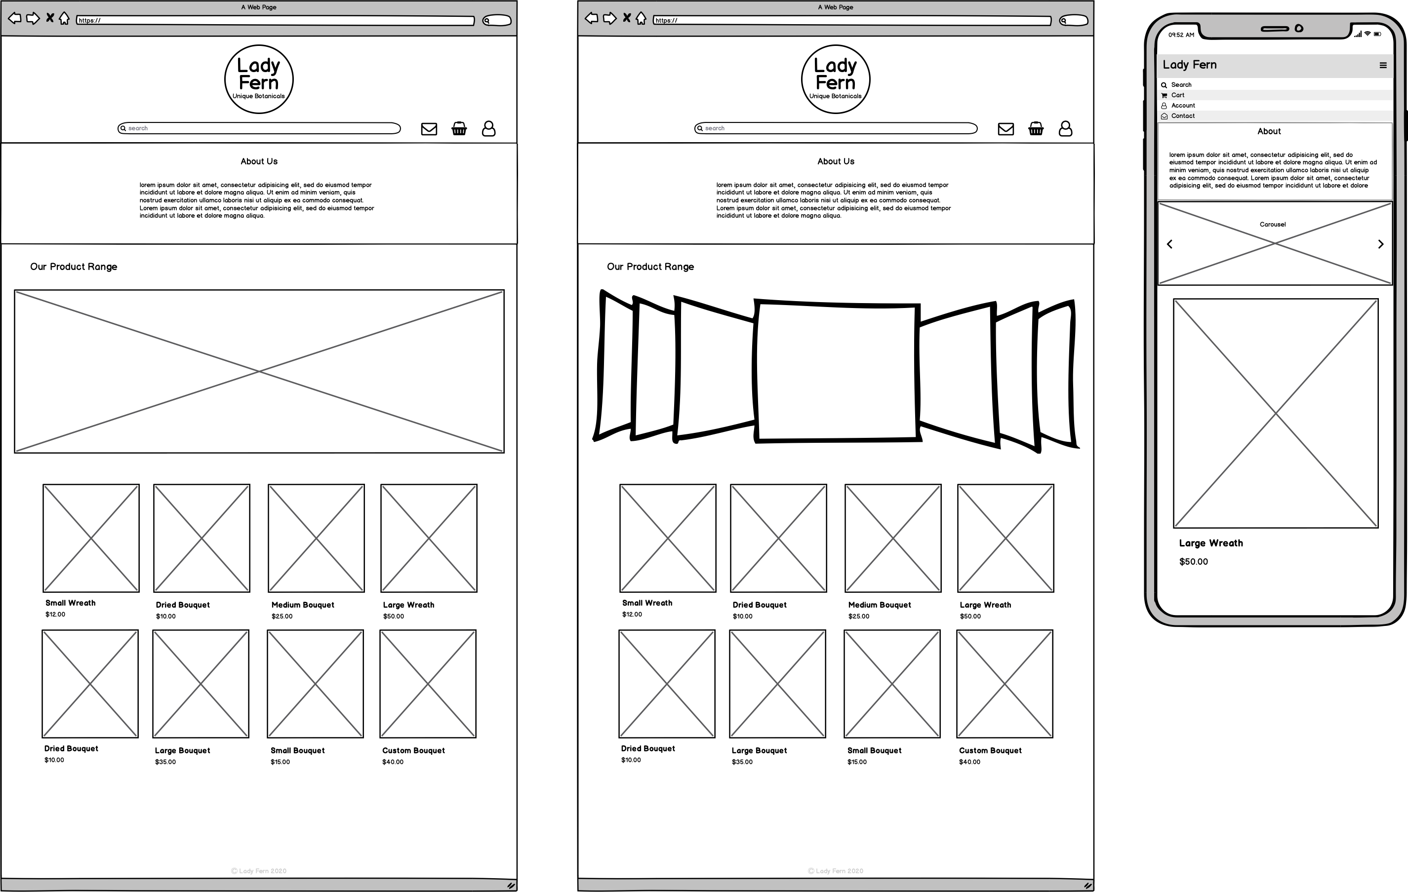
wireframes

Slide 8
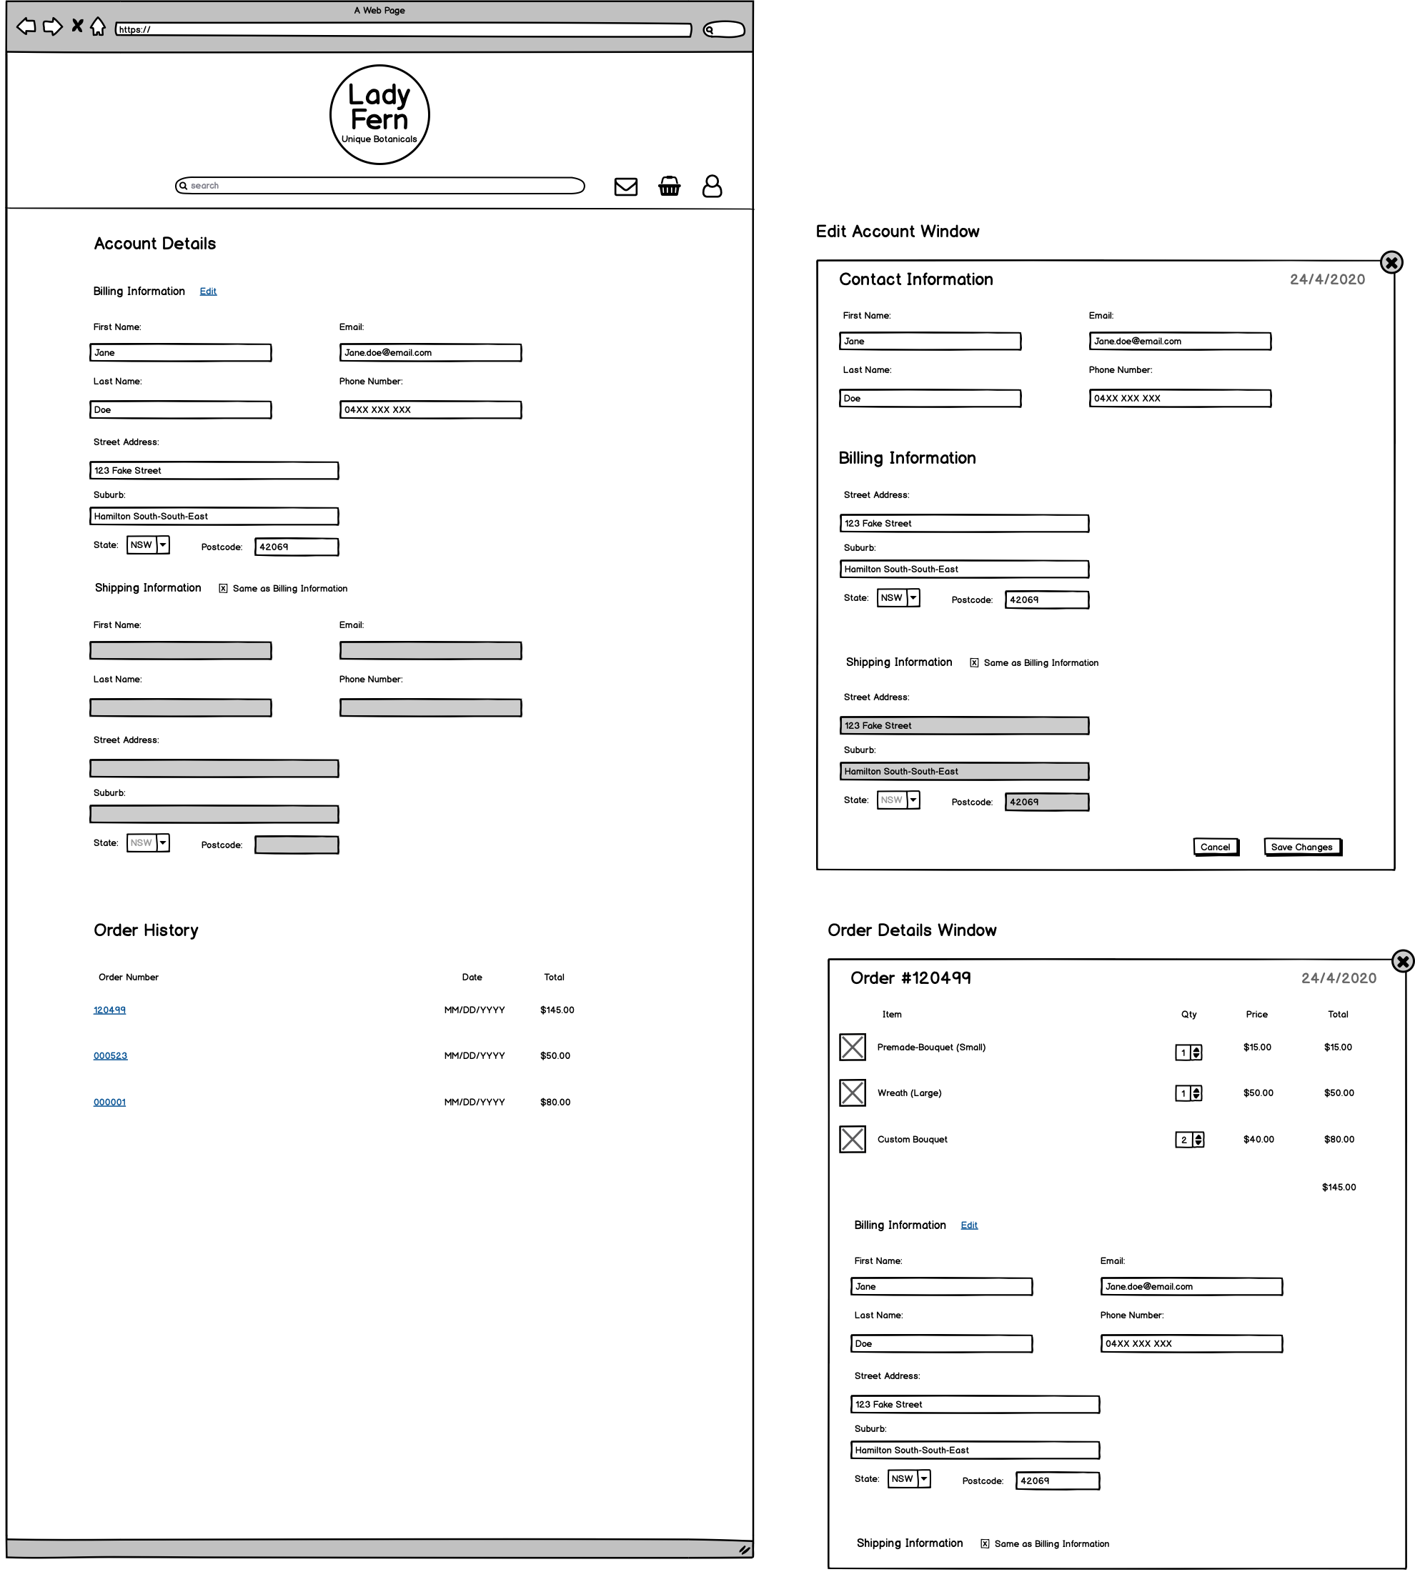
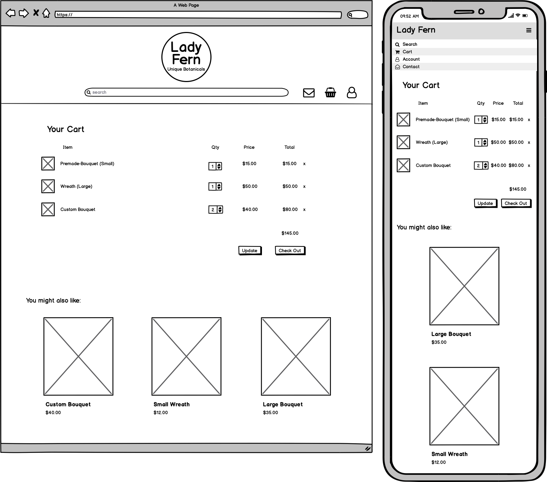

Slide 9
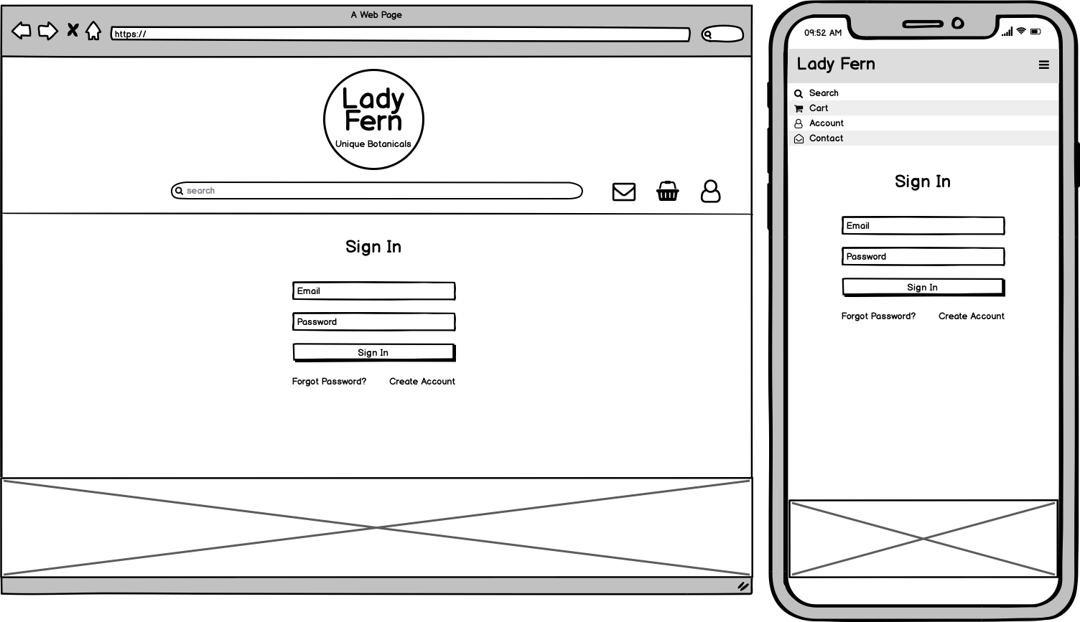
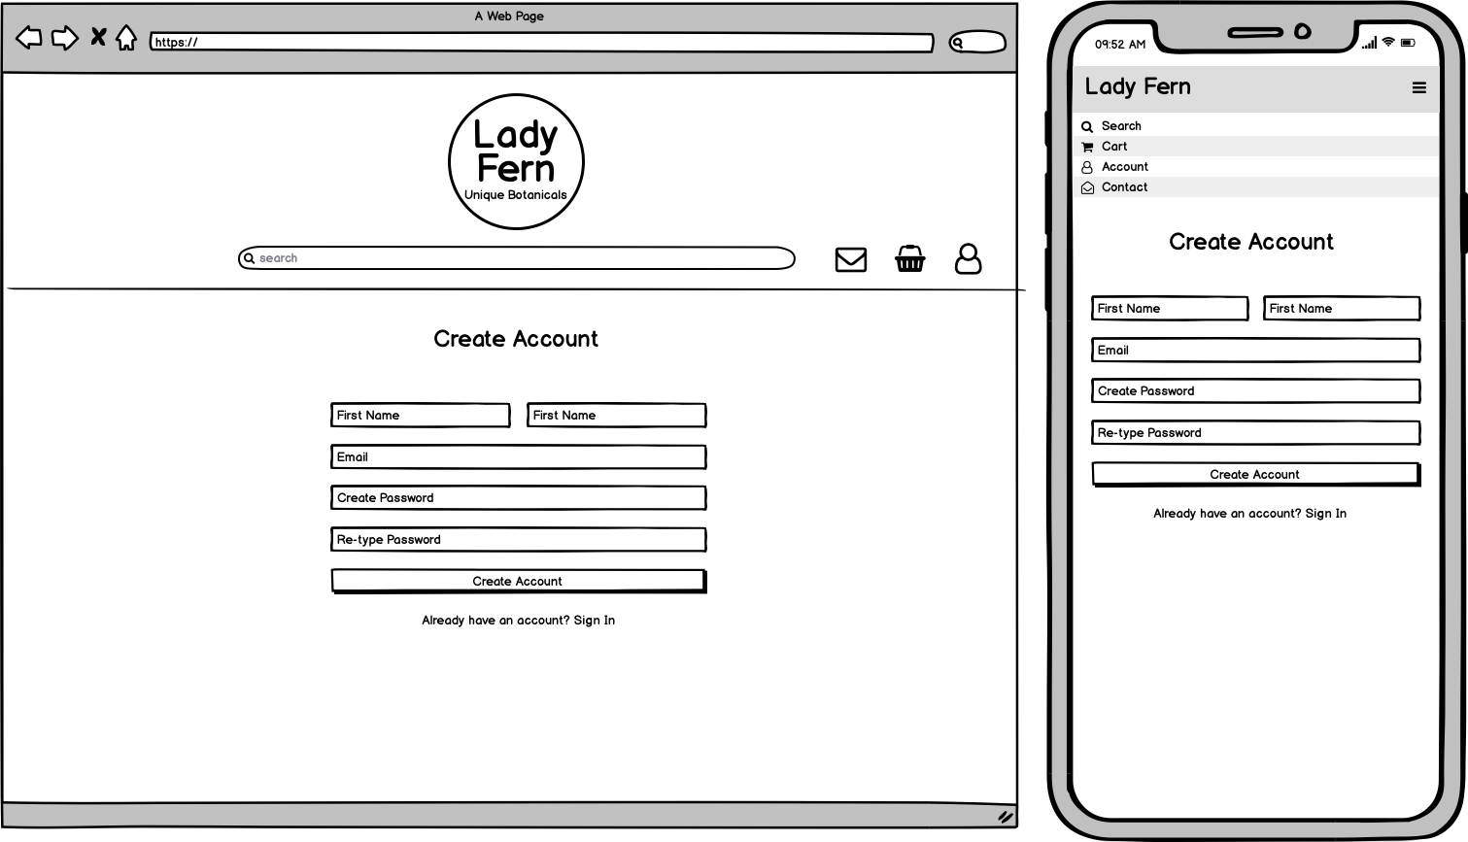
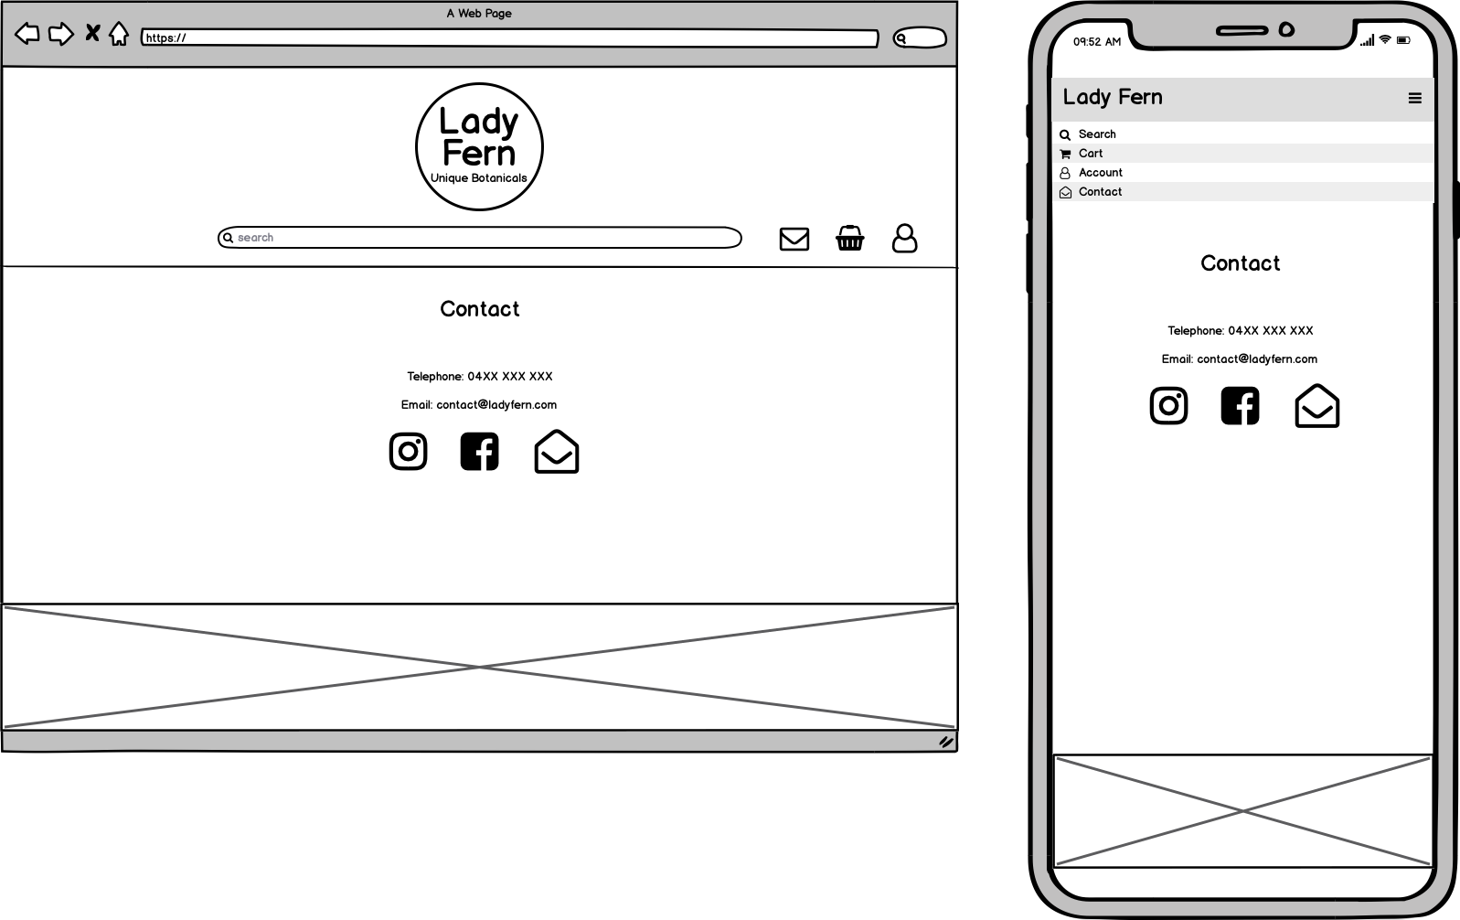

Slide 10
Entity relationship diagram

Slide 11
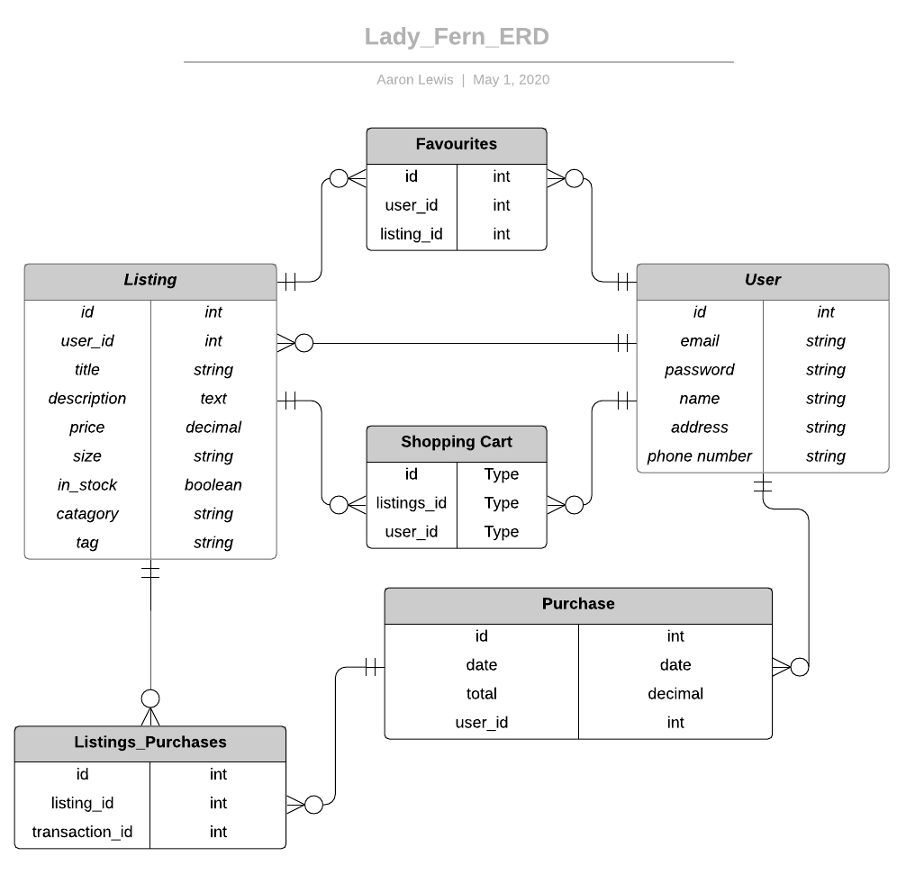

Slide 12
screenshots

Slide 13
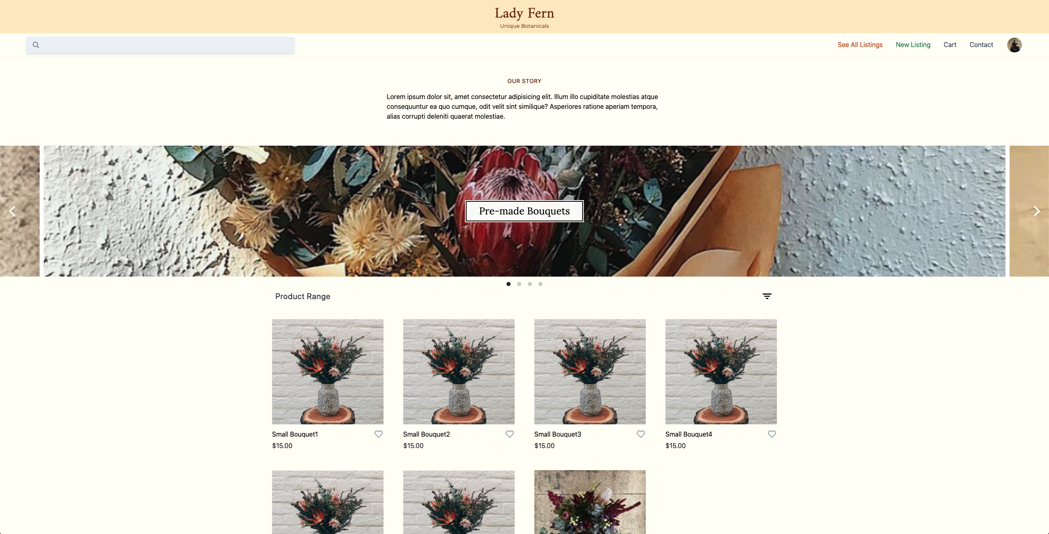

Slide 14
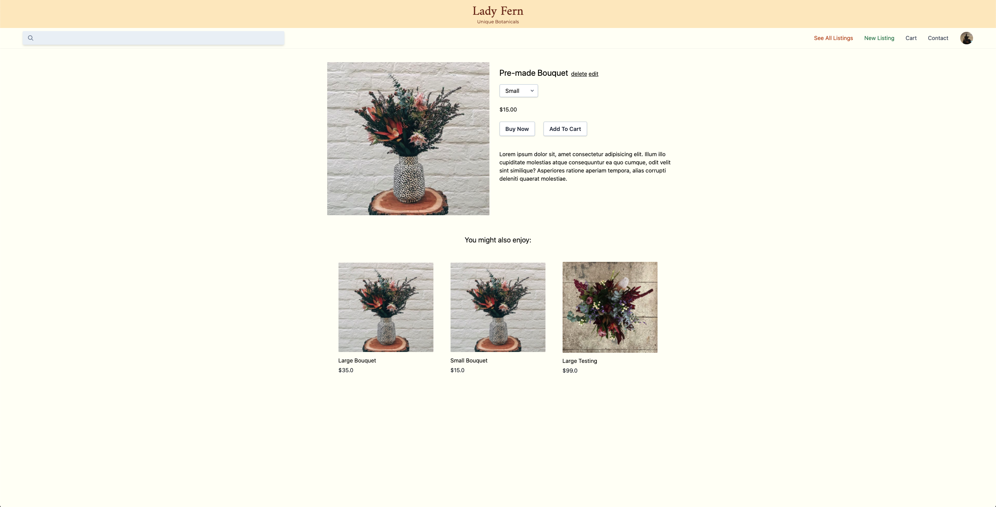

Slide 15
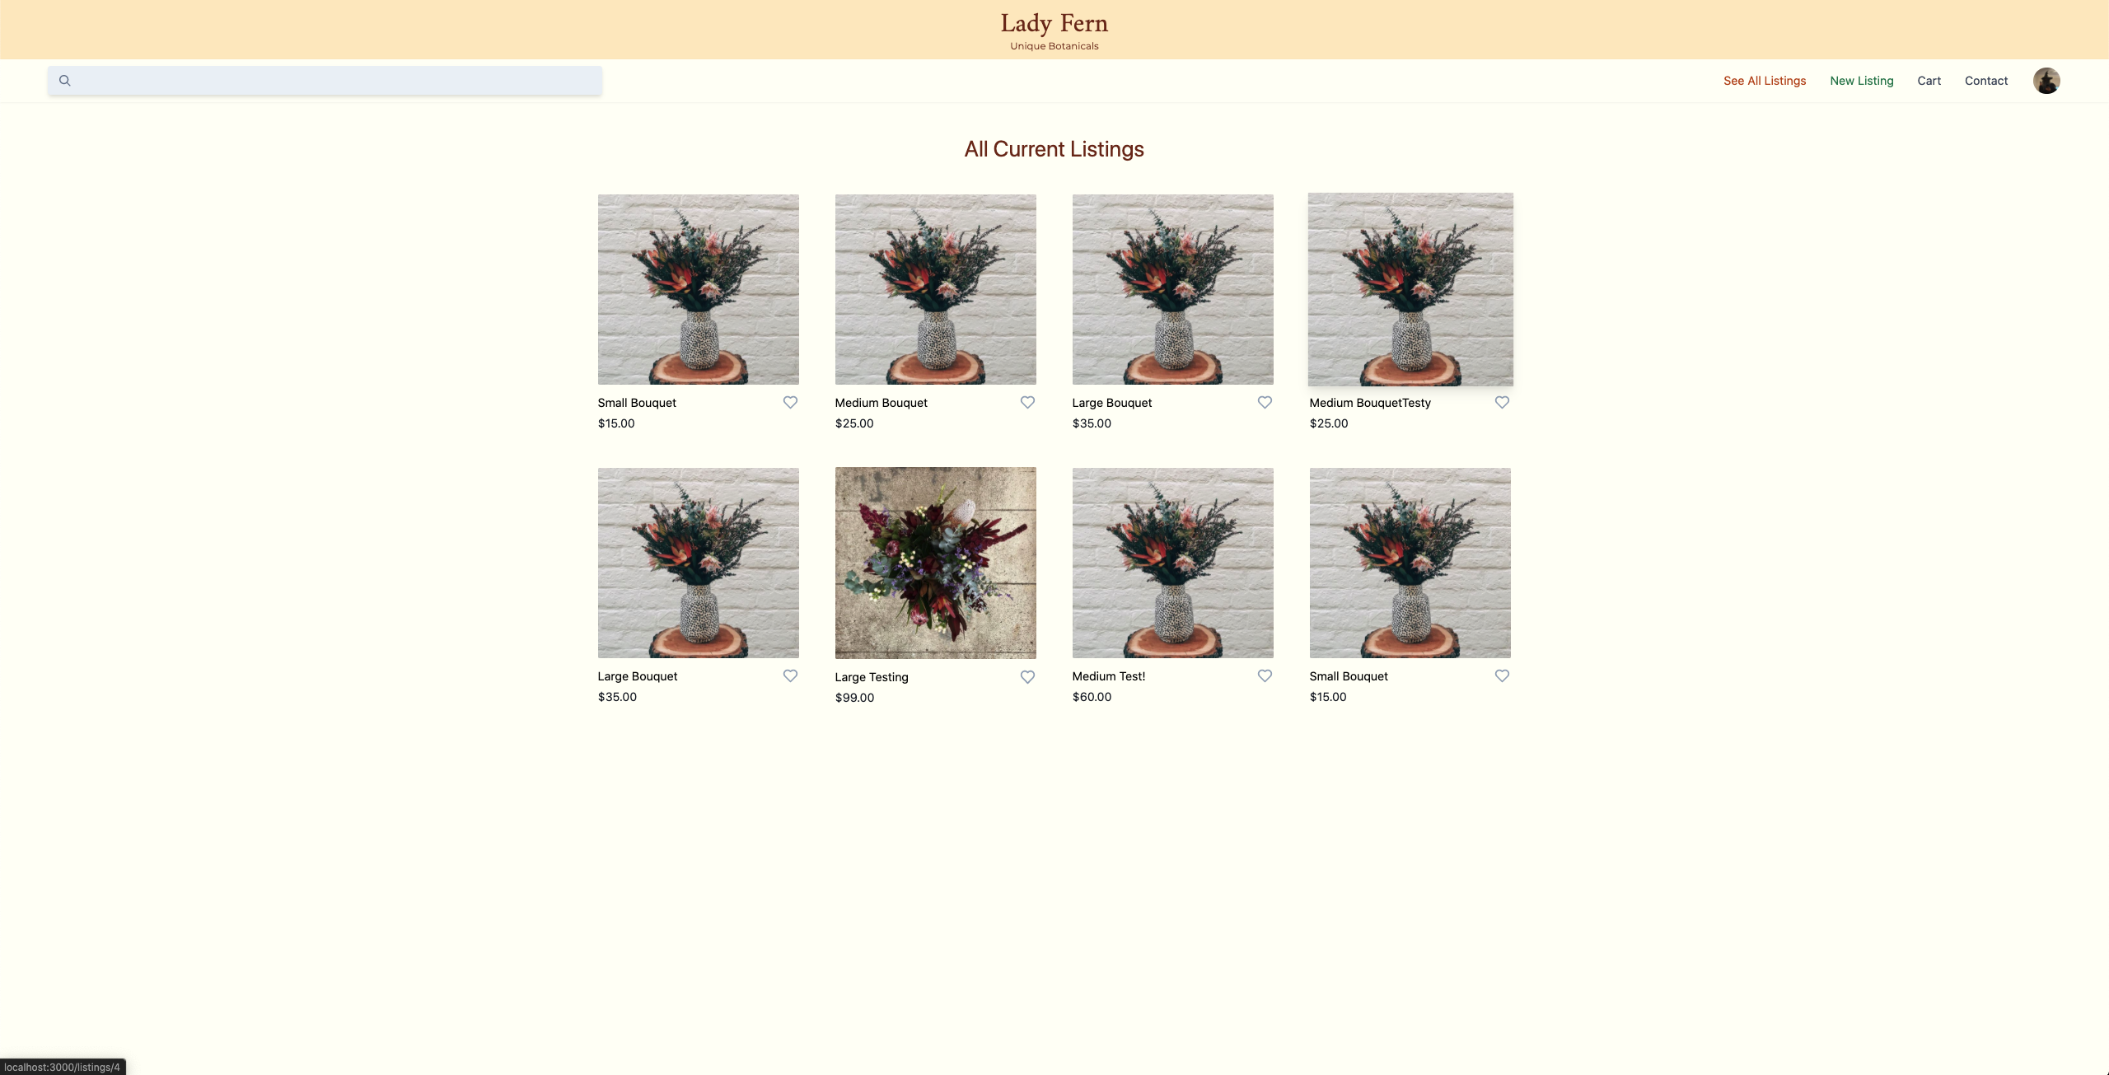

Slide 16
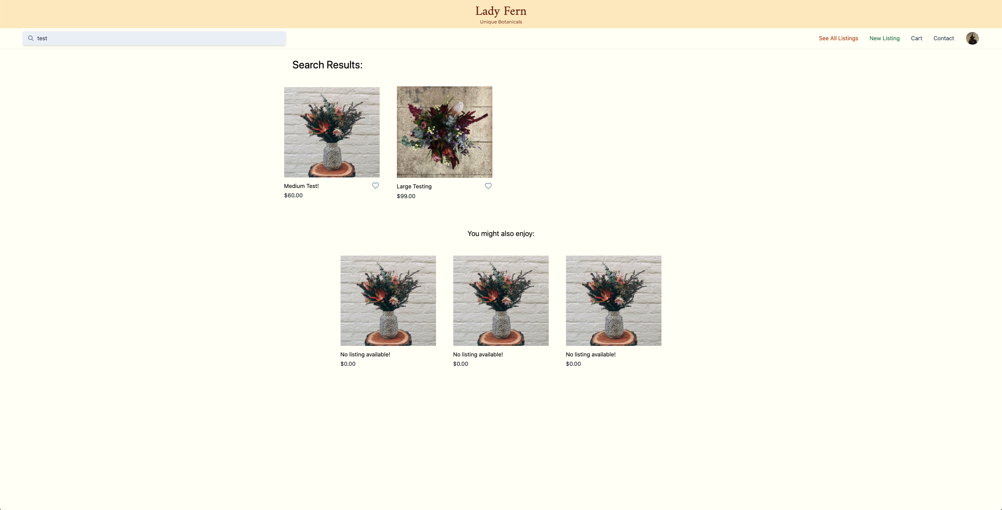

Slide 17
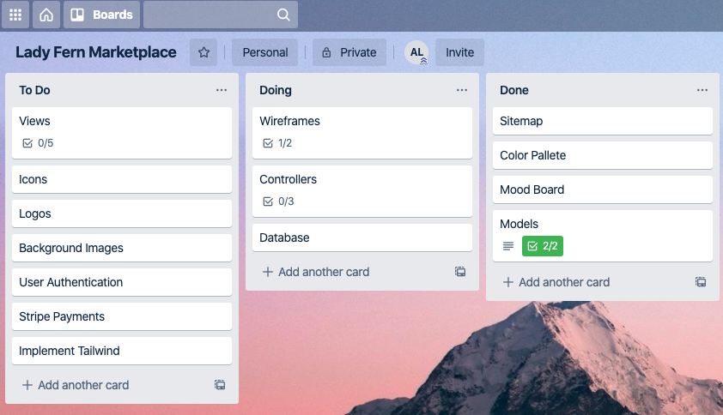
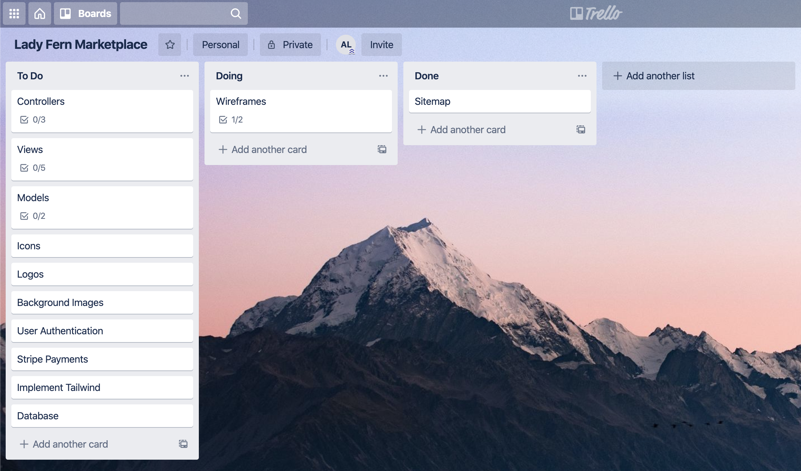
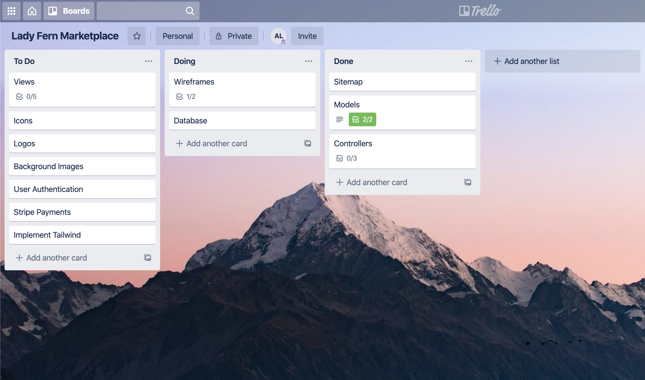
Project tracking
In order to track the progress of each task required to build the application, I made use of Trello.

Slide 18
Thank you

